Slide 1
COMPUTER APPLICATIONS
CHAPTER 10
HTML

Slide 2
WHAT IS HTML?
HTML is a language for describing web pages
HTML stands for Hyper Text Markup Language
HTML is a markup language
A markup language is a set of markup tags
The tags describe document content
HTML documents contain HTML tags and plain text
HTML documents are also called web pages

Slide 3
HTML TAGS
HTML tags are keywords (tag names) surrounded by angle brackets like <html>
HTML tags normally come in pairs like <b> and </b>
The first tag in a pair is the start tag, the second tag is the
end tag
The end tag is written like the start tag, with a forward
slash before the tag name
Start and end tags are also called opening tags and
closing tags

Slide 4
HTML ELEMENTS
"HTML tags" and "HTML elements" are often used to describe the same thing.
But strictly speaking, an HTML element is everything between the start tag and the end tag, including the tags:
HTML Element:
<p>This is a paragraph.</p>

Slide 5
THE <P> ELEMENT
The <p> element defines a paragraph in the HTML document.
The element has a start tag <p> and an end tag </p>.
<p>This is my first paragraph.</p>

Slide 6
THE <font> ELEMENT
The <font> tag specifies the font face, font size, and color of text.
<font size="2" face="verdana" color="blue"> This is some text! </font>
<font color="green"> This is some text! </font>
NB: The <font> tag is not supported in HTML5.

Slide 7
WHITE SPACE
White space refers to the empty spaces in a design. In HTML there are three characters that act as white space:
space
tab
carriage return (line feed)

Slide 8
WHITE SPACE
When you write your HTML, you can add any number of these white space characters into your HTML, but when you view that HTML in a Web page - all but one disappear!
This is very different from a word processor.

Slide 9
THE <br> ELEMENT
The <br> tag inserts a single line break.
The <br> tag is an empty tag which means that it has no end tag.
<p>This is <br> my second line. </p>

Slide 10
Non-Breaking Space
A non-breaking space is a white space character that HTML will not collapse.
Use the HTML code: &nbsp; or the numerical code &#160;
<p> &#160;&#160;&#160;this text is indented 3 spaces. </p>

Slide 11
Unordered HTML List
An unordered list starts with the <ul> tag. Each list item starts with the <li> tag.
The list items will be marked with bullets (small black circles) by default.
<ul>
<li>Coffee</li>
<li>Tea</li>
<li>Milk</li>
</ul>

Slide 12
Ordered HTML List
An ordered list starts with the <ol> tag. Each list item starts with the <li> tag.
The list items will be marked with numbers by default.
<ol>
<li>Coffee</li>
<li>Tea</li>
<li>Milk</li>
</ol>

Slide 13
THE <BODY> ELEMENT
The <body> element defines the body of the HTML document.
The element has a start tag <body> and an end tag
</body>.
<body>
<p>This is my first paragraph.</p>
</body>

Slide 14
THE <HTML> ELEMENT
The <html> element defines the whole HTML document.
The element has a start tag <html> and an end tag </html>.
<html>
<body>
<p>This is my first paragraph.</p>
</body>
</html>

Slide 15
HTML Text Formatting Elements
<b> | Defines bold text
<em> | Defines emphasized text
<i> | Defines italic text
<small> | Defines smaller text
<strong> | Defines important text
<sub> | Defines subscripted text
<sup> | Defines superscripted text
<ins> | Defines inserted text
<del> | Defines deleted text
<mark> | Defines marked/highlighted text

Slide 16
DON'T FORGET THE END TAG!!!
Some HTML elements might display correctly even if you forget the end tag.
<p>This is a paragraph
<p>This is a paragraph
Never rely on this!!!
Many HTML elements will produce unexpected results
and/or errors if you forget the end tag.

Slide 17
EMPTY HTML ELEMENTS
HTML elements with no content are called empty elements.
<br> is an empty element without a closing tag (the
<br> tag defines a line break).

Slide 18
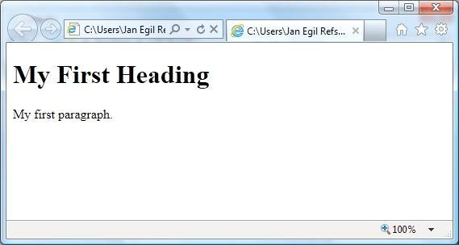
WEB BROWSERS
The purpose of a web browser (such as Google Chrome, Internet Explorer, Firefox, Safari) is to read HTML documents and display them as web pages.
The browser does not display the HTML tags, but uses the tags to determine how the content of the HTML page is to be presented/displayed to the user
10

Slide 19
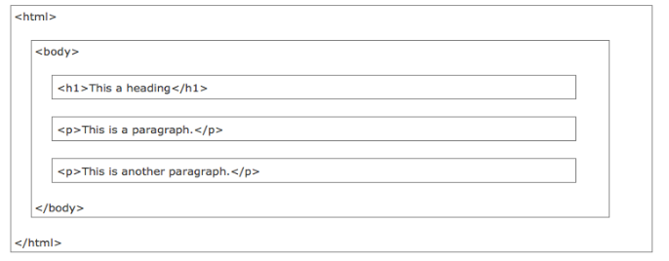
HTML PAGE STRUCTURE

Slide 20
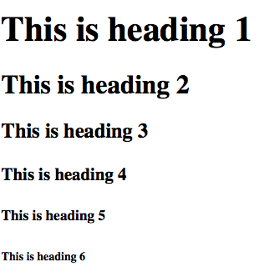
HTML HEADINGS
CODE
<!DOCTYPE html>
<html>
<body>
<h1>This is heading 1</h1>
<h2>This is heading 2</h2>
<h3>This is heading 3</h3>
<h4>This is heading 4</h4>
<h5>This is heading 5</h5>
<h6>This is heading 6</h6>
</body>
</html>
RESULT

Slide 21
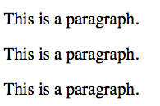
HTML PARAGRAPHS
CODE
<!DOCTYPE html>
<html>
<body>
<p>This is a paragraph.</p>
<p>This is a paragraph.</p>
<p>This is a paragraph.</p>
</body>
</html>
RESULT

Slide 22

HTML LINKS
CODE
<!DOCTYPE html>
<html>
<body>
<a href=http://www.lau.edu.lb>
This is a link</a>
</body>
</html>
RESULT

Slide 23

HTML IMAGES
CODE
<!DOCTYPE html>
<html>
<body>
<img src="squares.jpg" width="104" height="142">
</body>
</html>
RESULT
16

Slide 24
HTML TABLES
An HTML table is defined with the <table> tag
Each table row is defined with the <tr> tag
A table header is defined with the <th> tag
A table data/cell is defined with the <td> tag

Slide 25

HTML TABLES
<table style="width:100%">
<tr>
<th>First Name</th>
<th>First Name</th>
</tr>
<tr>
<td>Jill</td>
<td>Smith</td>
</tr>
<tr>
<td>Eve</td> <td>Jackson</td>
</tr>
</table>

Slide 26
Exercises
Print a paragraph with 4 - 5 sentences. Each sentence should be a different font.
Print a paragraph that is a description of a book, include the title of the book as well as its author. Names and titles should be underlined, adjectives should be italicized and bolded.
Print 2 paragraphs that are both indented using the &nbsp; command.
Create some links to various search engines (google, youtube, etc)
Display 3 different images. Skip 2 lines between each image. Each image should have a title.

